Slide 1
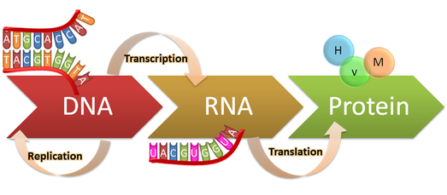
Matlab Homework 7:Microarray Gene Expression
In genetics, gene expression (genotype) gives rise to the phenotype, i.e. observable trait.
Mistakes in gene expression results in diseases in human
https://genius.com/Biology-genius-the-central-dogma-annotated

Slide 2
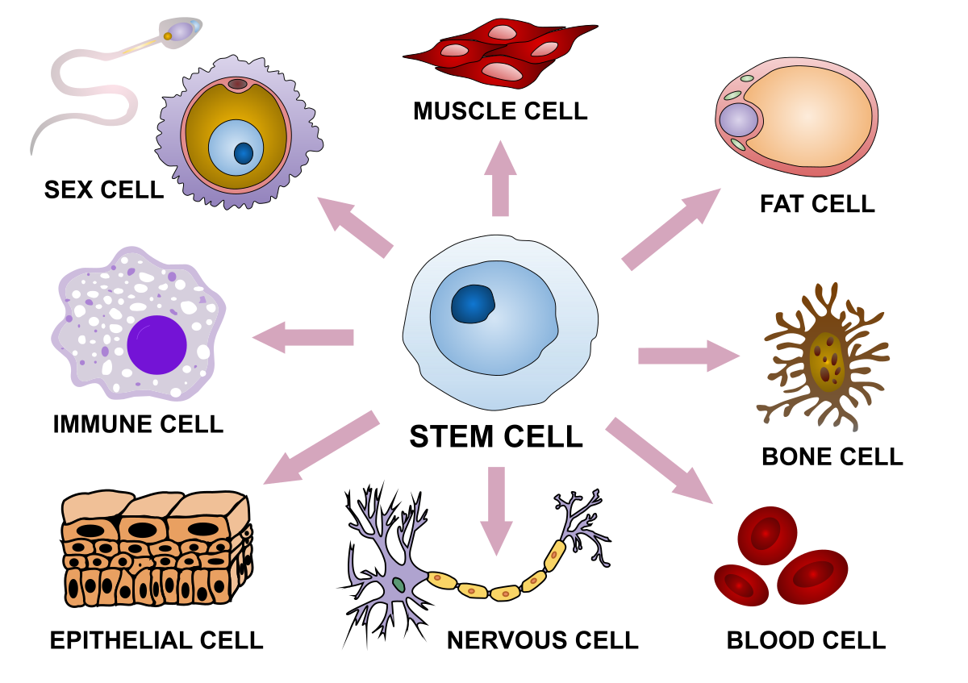
Differential gene expression (DGE)
Which genes are differentially expressed in the two tissue type populations
Which genes are differentially expressed normal tissue and disease tissue

Slide 3
Ways to quantify the gene expression
Single stranded RNA molecules are converted to single stranded DNA (cDNA complementary DNA molecules)
We are quantifying the amount of cDNA
Northern/Western blotting
Fluorescent in situ hybridization (FISH)
Reverse transcription polymerase chain reaction (RT-PCR)
Serial Analysis of Gene Expression (SAGE)
DNA microarray (high throughput)
RNA Sequencing (high throughput)

Slide 4
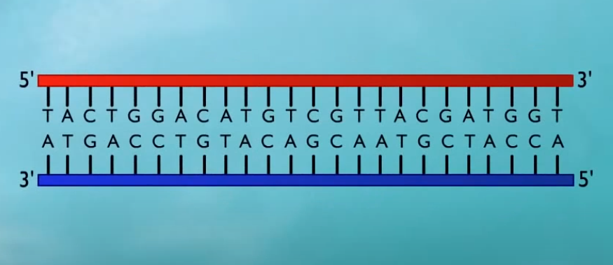
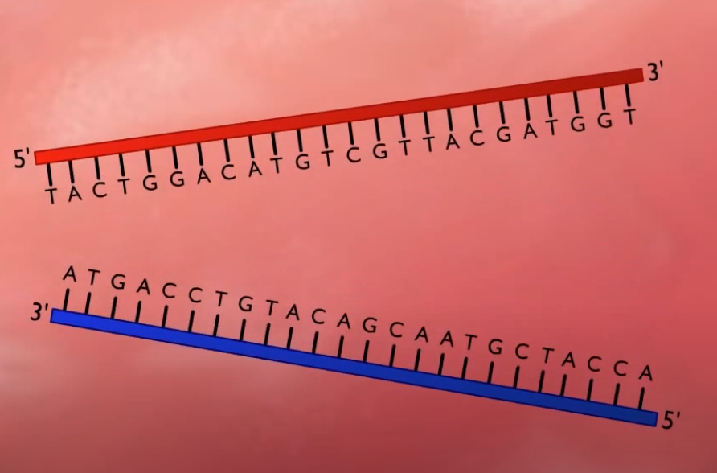
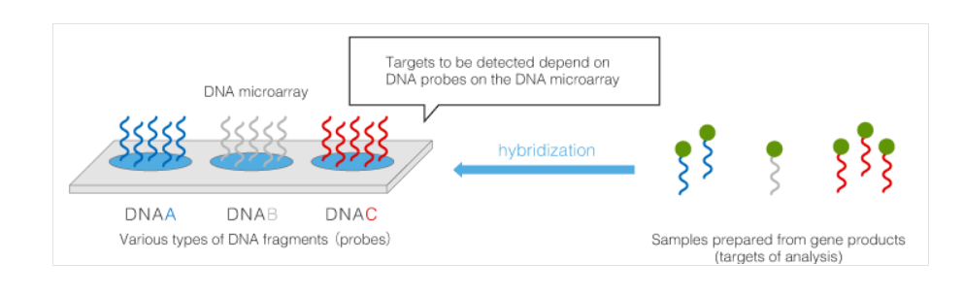
DNA microarray (high throughput) is based on the principle of DNA/RNA hybridization
Complementary sequences of two strands (A-T:G-C)
Same sequences
At high temperature, diassociate

Slide 5
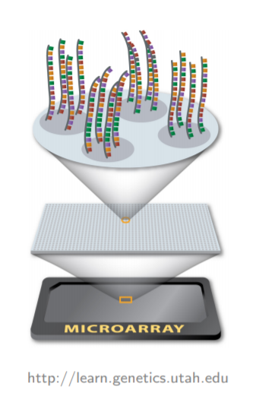
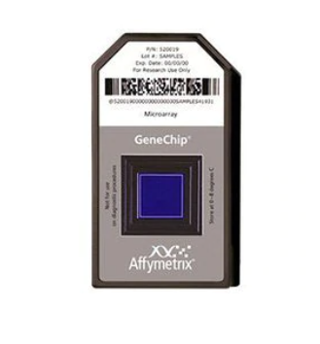
DNA microarray Fabrication

Slide 6
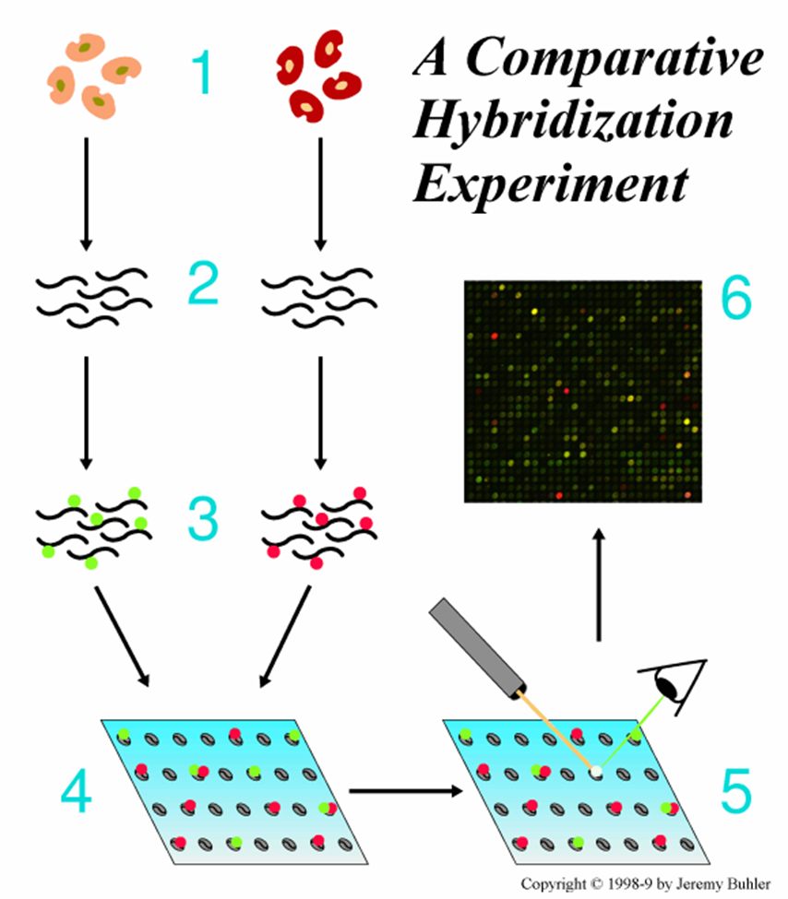
A typical comparative microarray experiment
Normal tissue
Cancer tissue
Extract RNA
Convert RNA to cDNA
and label them with green
color dye dUPT-cy3
Mix and hybridize on the array
http://www.bio.davidson.edu/Biology/Courses/genomics/chip/chip.html

Slide 7
Gene expression data analysis
Data collation
Data normalization
Clustering and Classification
Databases and software

Slide 8
Gene expression data example
Data on m genes for n samples
ID_REF | GSM136326 | GSM136327 | GSM136328 | GSM136329 | GSM136330 | GSM136331
1007_s_at | 10.4502763 | 9.3995422 | 9.42479936 | 9.472922422 | 9.27878032 | 9.434427931
1053_at | 5.71946574 | 4.84929333 | 4.73208086 | 4.728854347 | 5.32639216 | 5.230320408
117_at | 5.93866366 | 6.08327317 | 6.44797814 | 6.17694869 | 6.54458475 | 6.07779478
121_at | 8.0230524 | 7.8946588 | 8.34498775 | 8.163203547 | 8.23375629 | 7.595105829
1255_g_at | 3.95480312 | 3.96324647 | 3.96410203 | 4.087835849 | 3.99889298 | 3.839704814
1294_at | 7.9090045 | 8.36397325 | 8.27191179 | 8.358196216 | 7.69999823 | 8.274305066
1316_at | 6.50101269 | 7.06478465 | 6.84193046 | 7.16941856 | 6.47412502 | 6.182111503
1320_at | 4.46782927 | 4.44699592 | 4.55541274 | 4.660870385 | 4.74765838 | 4.484930349
1405_i_at | 6.98704598 | 6.91061747 | 6.70850464 | 7.777802579 | 7.74606814 | 7.576616437
1431_at | 3.78442846 | 3.84921957 | 3.86910251 | 4.06116236 | 3.90178173 | 3.669844515
1438_at | 6.33719475 | 6.35968637 | 6.26322624 | 6.571037625 | 6.41512718 | 5.992213616
1487_at | 7.6496267 | 7.16653011 | 7.25328005 | 7.228355117 | 7.14035537 | 7.626439717

Slide 9
Gene Clustering and Classification
Clustering can be accomplished based on genes, samples, and/or time variable, depending on the type of dataset
Gene-based clustering and sample-based clustering
Genes form a cluster that displays related expression across conditions, while samples form a cluster that displays related expression across all genes
Goals:
Identify gene classes / gene correlations / gene functions
Support biological analysis / discovery (pathways, regulatory sites)
Identify the different gene expression pattern in diseases

Slide 10
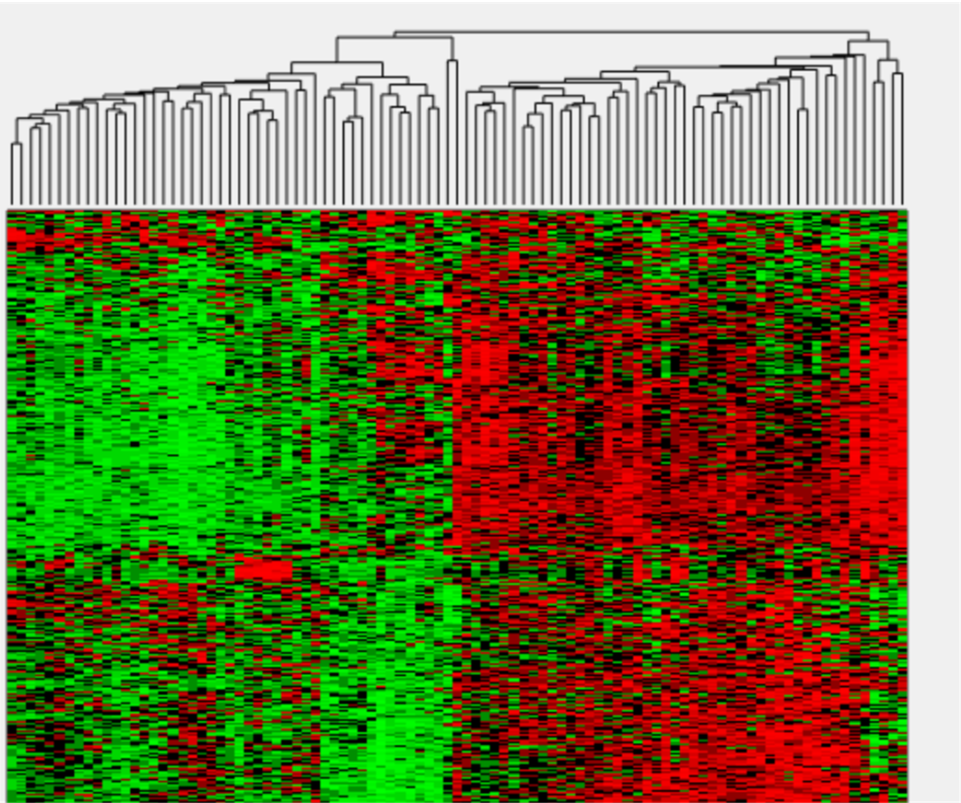
Gene Clustering

Slide 11
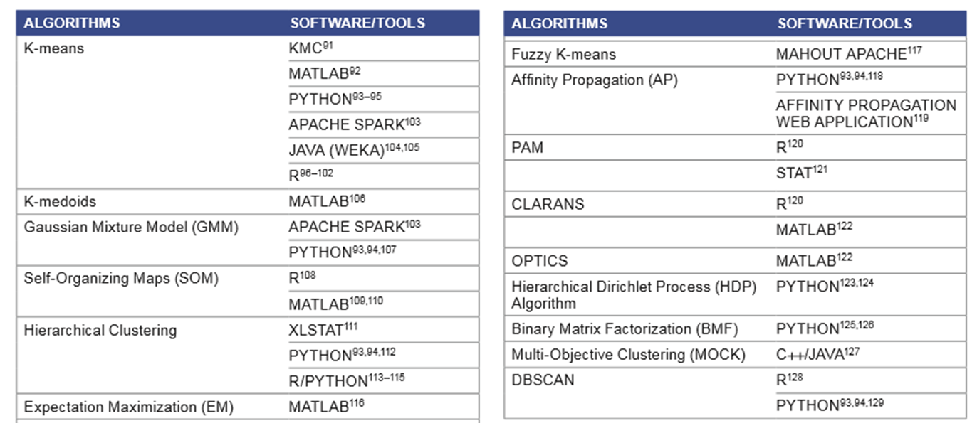
Databases and software
Deposit data in the public database(http://www.ncbi.nlm.nih.gov/geo/)
Oyelade, J. et al. (2016) Clustering algorithms: their application to gene expression data. Bioinformatics and Biology insights, 10, BBI. S38316.

Slide 12
Deposit data in the public database
(http://www.ncbi.nlm.nih.gov/geo/)

Slide 13
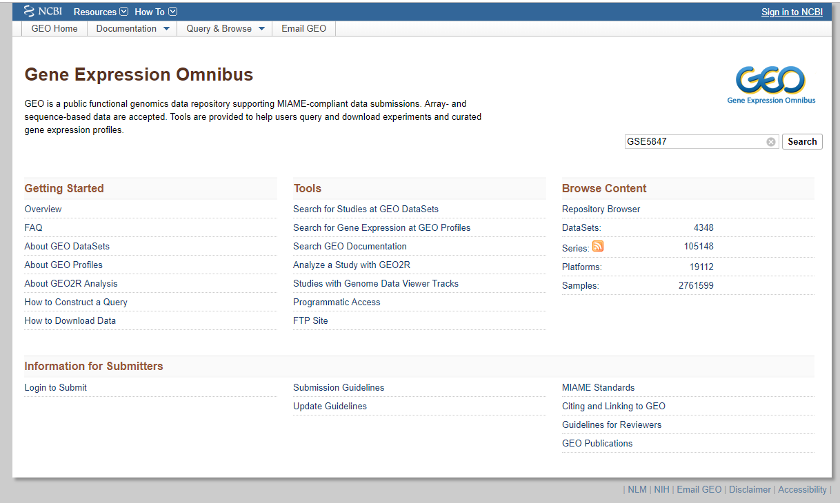
Data description:(http://www.ncbi.nlm.nih.gov/geo/)

Slide 14
GEO data types
GSM: An individual microarray sample (e.g., patient, or tissue).
GSE: A Series, representing an experimental study. A GSE contains one or more GSM entries.
Probe-GSM-data(intensity ratio)
GPL: Platform data, containing information about microarray probes. Each GSM sample is associated with a GPL. E.g., to find out the gene symbols for a GSM, you would need to consult with the GPL used in that study.
Probe-Gene

Slide 15
Data description:(http://www.ncbi.nlm.nih.gov/geo/)

Slide 16
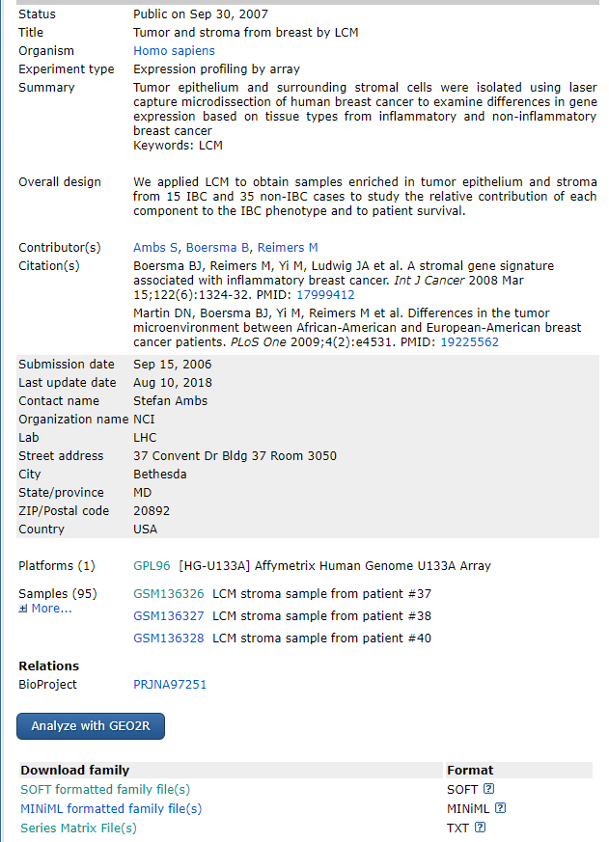
GSE:
Three sections:
Header.Series structure
Header.Samples structure
!series_matrix_table
You can download the file
GSE5847_series_matrix which is already in your folder
!series_matrix_table
Row: sample names
Column: probe information
No gene information (GPL)

Slide 17
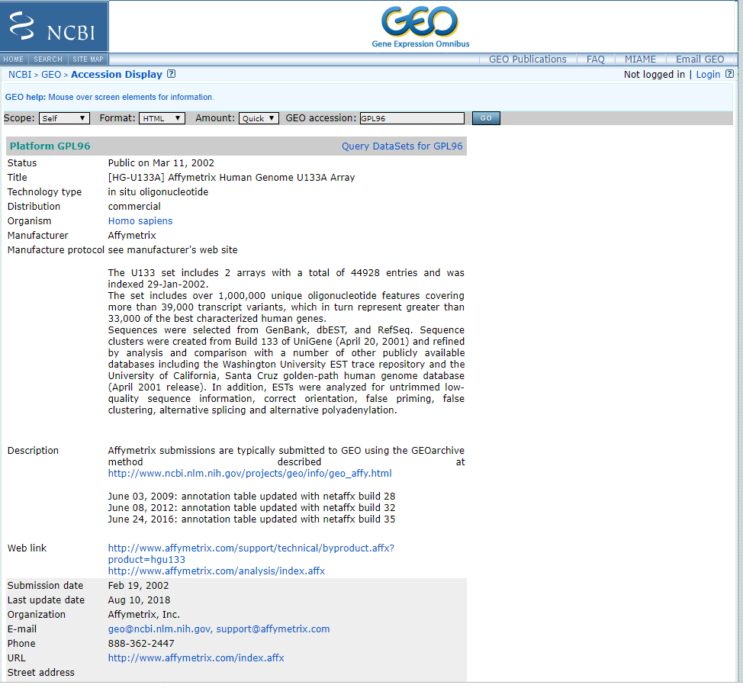
GPL:
Related to the type of arrays.
Define the probes for genes
Three sections:
^PLATFORM = GPL96
#ID = Affymetrix Probe Set ID LINK_PRE:"https://www.affymetrix.com/LinkServlet?array=U133&probeset="
!platform_table_begin
We are only interested in the platform_table
Column: detailed information of the probes used
Row: probe name

Slide 18
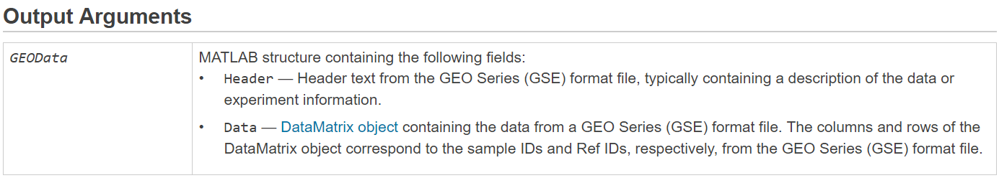
bmes_downloadandparsegse5
url = sprintf('ftp://ftp.ncbi.nih.gov/pub/geo/DATA/SeriesMatrix/%s/%s_series_matrix.txt.gz','GSE5847','GSE5847');
gzfile = [tempdir '/' sprintf('%s.txt.gz','GSE5847')];
fprintf('Downloading %s ...\n',url);
urlwrite(url, gzfile);
files = gunzip( gzfile );
file = files{1};
fprintf('Reading %s ...\n',file);
gsedata = geoseriesread( file );
Geoseriesread bioinformatics toolbox
Read Gene Expression Omnibus (GEO) Series (GSE) format data
Syntax
GEOData = geoseriesread(File)
https://www.mathworks.com/help/bioinfo/ref/geoseriesread.html

Slide 19
bmes_downloadandparsegpl7
url = sprintf('https://www.ncbi.nlm.nih.gov/geo/query/acc.cgi?form=text&acc=%s&view=full',gplid);
file = [tempdir '/' 'GPL96' '.txt'];
urlwrite(url, file);
gpldata = geosoftread( file );
geosoftread
Read Gene Expression Omnibus (GEO) SOFT format data
Syntax
GEOSOFTData = geosoftread(File)
https://www.mathworks.com/help/bioinfo/ref/geosoftread.html
GEOSOFTData | MATLAB structure containing information from a GEO SOFT format file.
Fields | Description
Scope | Type of file read (SAMPLE, DATASET, or PLATFORM)
Accession | Accession number for record in GEO database.
Header | Microarray experiment information.
ColumnDescriptions | Cell array containing descriptions of columns in the data.
ColumnNames | Cell array containing names of columns in the data.
Data | Array containing microarray data.
Identifier (GDS files only) | Cell array containing probe IDs.
IDRef (GDS files only) | Cell array containing indices to probes.

Slide 20
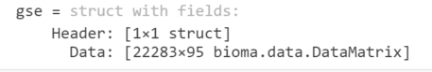
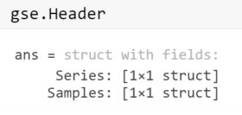
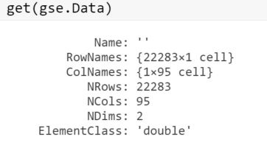
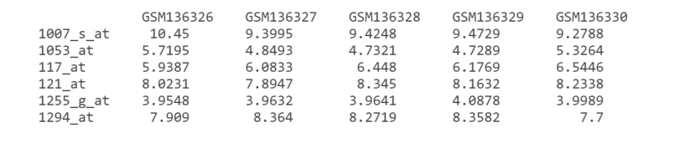
GSE: Data Structures After Downloading
Gse.data. DataMatrix object, similar to a Matlab table but with row and column names
You need to follow the rules of DataMatrix object
log2
d=

Slide 21
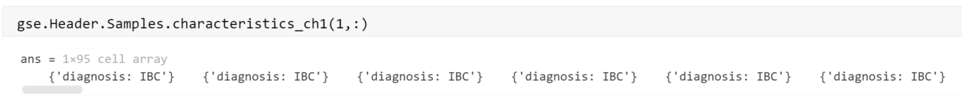
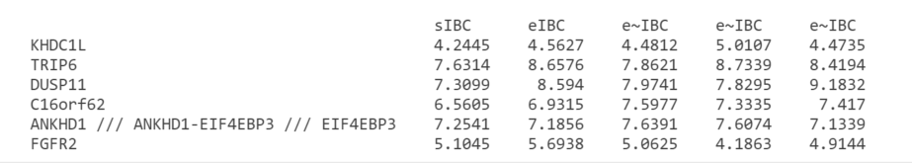
d: after changing column and row names

Slide 22
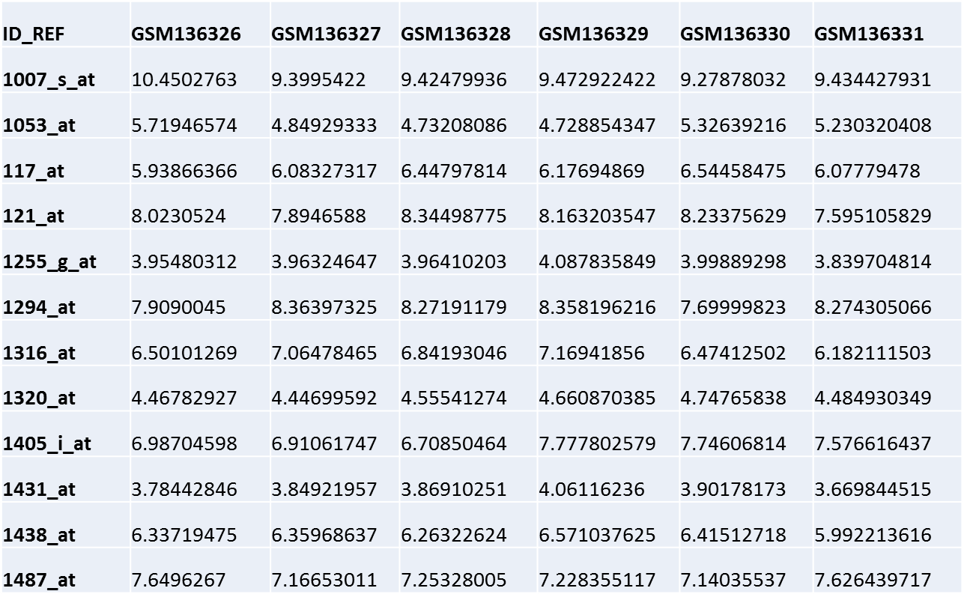

Gene expression statistical analysis
Clustering: segregate data points with similar traits and assign them into clusters
Hierarchical Clustering (no pre-specified number of clusters)
K-means Clustering (pre-specified number of clusters)
Principal Component Analysis (PCA)

Slide 23
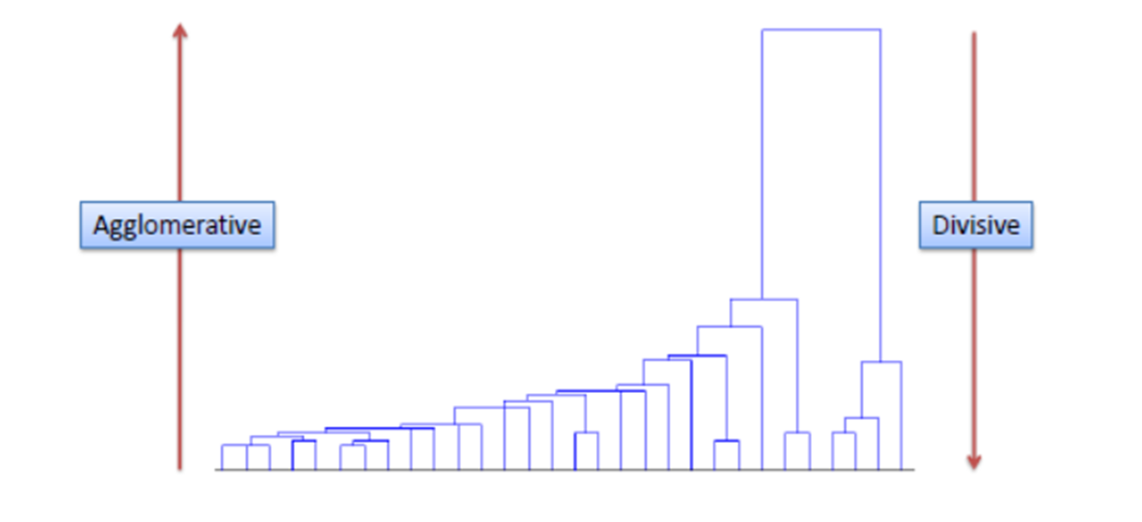
Hierarchical Clustering
An algorithm that groups similar objects into groups called clusters
Agglomerative: This is a "bottom-up" approach: each data point starts in its own cluster, and pairs of clusters are merged as one moves up the hierarchy.
Divisive: This is a "top-down" approach: all data points start in one cluster, and splits are performed recursively as one moves down the hierarchy

Slide 24
An Example of Agglomerative Clustering
Start by assigning each item to its own cluster, so that if you have N items, you now have N clusters, each containing just one item. Let the distances (similarities) between the clusters equal the distances (similarities) between the items they contain.
Find the closest (most similar) pair of clusters and merge them into a single cluster, so that now you have one less cluster.
Compute distances (similarities) between the new cluster and each of the old clusters.
Repeat steps 2 and 3 until all items are clustered into a single cluster of size N.

Slide 25
Step 1. Start by assigning each item to its own cluster
 | BOS | NY | DC | MIA | CHI | SEA | SF | LA | DEN
BOS | 0 | 206 | 429 | 1504 | 963 | 2976 | 3095 | 2979 | 1949
NY | 206 | 0 | 233 | 1308 | 802 | 2815 | 2934 | 2786 | 1771
DC | 429 | 233 | 0 | 1075 | 671 | 2684 | 2799 | 2631 | 1616
MIA | 1504 | 1308 | 1075 | 0 | 1329 | 3273 | 3053 | 2687 | 2037
CHI | 963 | 802 | 671 | 1329 | 0 | 2013 | 2142 | 2054 | 996
SEA | 2976 | 2815 | 2684 | 3273 | 2013 | 0 | 808 | 1131 | 1307
SF | 3095 | 2934 | 2799 | 3053 | 2142 | 808 | 0 | 379 | 1235
LA | 2979 | 2786 | 2631 | 2687 | 2054 | 1131 | 379 | 0 | 1059
DEN | 1949 | 1771 | 1616 | 2037 | 996 | 1307 | 1235 | 1059 | 0

Slide 26
Step 2. Find the closest (most similar) pair of clusters and merge them into a single cluster, so that now you have one less cluster. BOS merged with NY
 | BOS/NY | DC | MIA | CHI | SEA | SF | LA | DEN
BOS/NY | 0 | 223 | 1308 | 802 | 2815 | 2934 | 2786 | 1771
DC | 223 | 0 | 1075 | 671 | 2684 | 2799 | 2631 | 1616
MIA | 1308 | 1075 | 0 | 1329 | 3273 | 3053 | 2687 | 2037
CHI | 802 | 671 | 1329 | 0 | 2013 | 2142 | 2054 | 996
SEA | 2815 | 2684 | 3273 | 2013 | 0 | 808 | 1131 | 1307
SF | 2934 | 2799 | 3053 | 2142 | 808 | 0 | 379 | 1235
LA | 2786 | 2631 | 2687 | 2054 | 1131 | 379 | 0 | 1059
DEN | 1771 | 1616 | 2037 | 996 | 1307 | 1235 | 1059 | 0

Slide 27
Step 3. Find the closest (most similar) pair of clusters and merge them into a single cluster, so that now you have one less cluster. BOS/NY merged with DC
 | BOS/NY/DC | MIA | CHI | SEA | SF | LA | DEN
BOS/NY/DC | 0 | 1308 | 802 | 2815 | 2934 | 2786 | 1771
MIA | 1308 | 0 | 1329 | 3273 | 3053 | 2687 | 2037
CHI | 802 | 1329 | 0 | 2013 | 2142 | 2054 | 996
SEA | 2815 | 3273 | 2013 | 0 | 808 | 1131 | 1307
SF | 2934 | 3053 | 2142 | 808 | 0 | 379 | 1235
LA | 2786 | 2687 | 2054 | 1131 | 379 | 0 | 1059
DEN | 1771 | 2037 | 996 | 1307 | 1235 | 1059 | 0
LA and SF become the closet, they will merge and for a new cluster

Slide 28
Step 3. Compute distances (similarities) between the new cluster and each of the old clusters. Then LA merged with SF
 | BOS/NY/DC | MIA | CHI | SEA | SF/LA | DEN
BOS/NY/DC | 0 | 1075 | 671 | 2684 | 2631 | 1616
MIA | 1075 | 0 | 1329 | 3273 | 2687 | 2037
CHI | 671 | 1329 | 0 | 2013 | 2054 | 996
SEA | 2684 | 3273 | 2013 | 0 | 808 | 1307
SF/LA | 2631 | 2687 | 2054 | 808 | 0 | 1059
DEN | 1616 | 2037 | 996 | 1307 | 1059 | 0
The cluster of BOS/NYC/DC is the closest to CHI

Slide 29
Repeat Step 2 and 3
LA/SF merged with SEA
 | BOS/NY/DC/CHI | MIA | SEA | SF/LA | DEN
BOS/NY/DC/CHI | 0 | 1075 | 2013 | 2054 | 996
MIA | 1075 | 0 | 3273 | 2687 | 2037
SEA | 2013 | 3273 | 0 | 808 | 1307
SF/LA | 2054 | 2687 | 808 | 0 | 1059
DEN | 996 | 2037 | 1307 | 1059 | 0
BOS/NY/DC/CHI/ merged with DEN
 | BOS/NY/DC/CHI | MIA | SF/LA/SEA | DEN
BOS/NY/DC/CHI | 0 | 1075 | 2013 | 996
MIA | 1075 | 0 | 2687 | 2037
SF/LA/SEA | 2054 | 2687 | 0 | 1059
DEN | 996 | 2037 | 1059 | 0

Slide 30
BOS/NY/DC/CHI/DEN merged with SF/LA/SEA
 | BOS/NY/DC/CHI/DEN | MIA | SF/LA/SEA
BOS/NY/DC/CHI/DEN | 0 | 1075 | 1059
MIA | 1075 | 0 | 2687
SF/LA/SEA | 1059 | 2687 | 0
BOS/NY/DC/CHI/DEN/SF/LA/SEA merged with MIA
 | BOS/NY/DC/CHI/DEN/SF/LA/SEA | MIA
BOS/NY/DC/CHI/DEN/SF/LA/SEA | 0 | 1075
MIA | 1075 | 0

Slide 31
Now trace back to the clustering process
plot the dendrogram
BOS merged with NY
BOS/NY merged with DC
LA merged with SF and LA/SF merged with SEA
BOS/NY/DC/CHI/ merged with DEN
BOS/NY/DC/CHI/DEN merged with SF/LA/SEA
BOS/NY/DC/CHI/DEN/SF/LA/SEA merged with MIA
MIA
SEA
SF
LA
BOS
NY
CHI
DEN
DC
206
233
379
671
808
996
1059
1075
206
379
233
671
808
996
1059
1075

Slide 32
What is k-Means Cluster Analysis?
k-means cluster analysis is an algorithm that groups similar objects into groups called clusters.
K-means clustering is one of the simplest and popular unsupervised machine learning algorithms.
The K-means algorithm identifies k number of centroids (a centroid is the imaginary or real location representing the center of the cluster), and then allocates every data point to the nearest cluster, while keeping the centroids as small as possible.

Slide 33
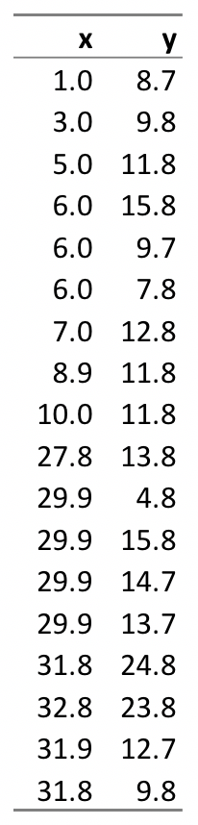
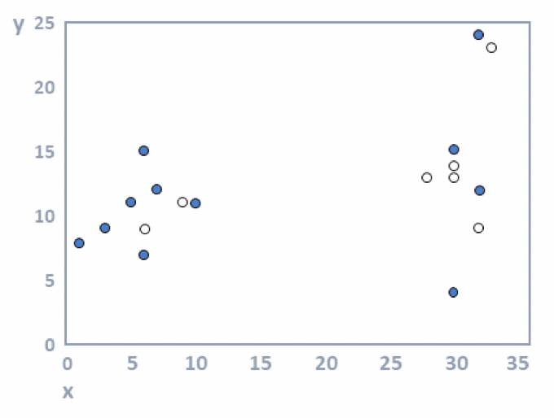
In the diagram, the 18 objects have been represented by dots on a scatterplot, where x is shown by the horizontal position of each object and y by the vertical. The objects have been randomly assigned to the two clusters (k = 2), where one cluster is shown with filled dots and the other with unfilled dots.
How k-means cluster analysis works
Step 1: Specify the number of clusters (k). The first step in k-means is to specify the number of clusters, which is referred to as k. Traditionally researchers will conduct k-means multiple times, exploring different numbers of clusters (e.g., from 2 through 10).
Step 2: Allocate objects to clusters. The most straightforward approach is to randomly assign objects to clusters, but there are many other approaches (e.g., using hierarchical clustering).

Slide 34
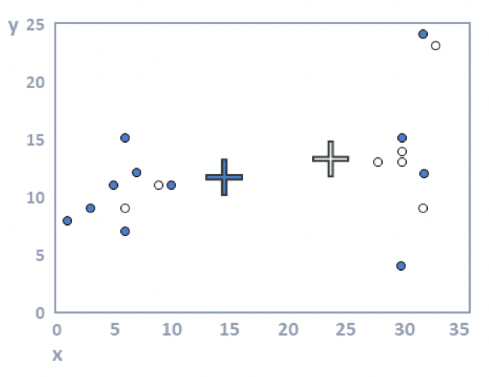
Step 3: Compute cluster means. For each cluster, the average value is computed for each of the variables. In the plot below, the average value of the filled dots for the variable represented by the horizontal position (x) of the dots is around 15; for the variable on the vertical dimension, it is around twelve. These two means are represented by the filled cross. Or, stated slightly differently: the filled cross is in the middle of the black dots. Similarly, the white cross is in the middle of the white dots. These crosses are variously referred to as the cluster centers, cluster means, and cluster medoids.

Slide 35
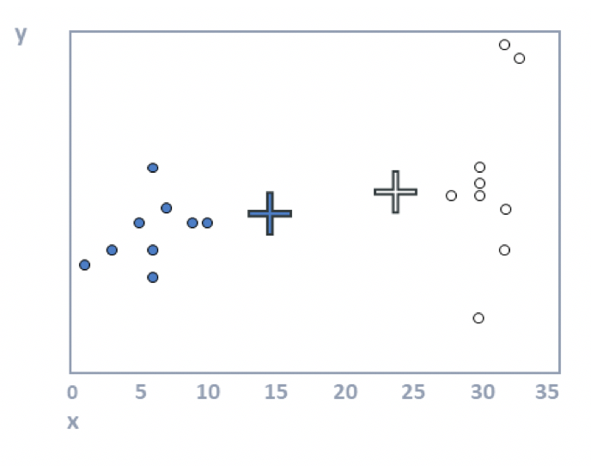
Step 4: Allocate each observation to the closest cluster center. In the plot above, some of the filled dots are closer to the white cross and some of the white dots are closer to the black cross. When we reallocate the observations to the closest clusters we get the plot below.
Randomly assigned clusters
New clusters

Slide 36
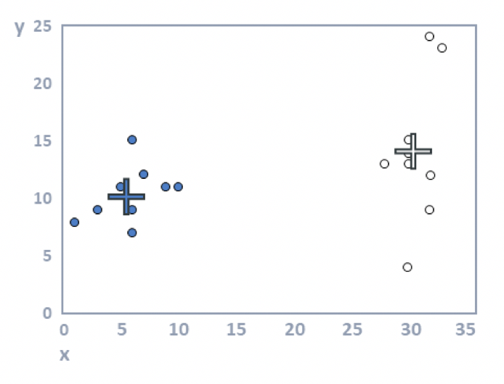
Step 5: Repeat steps 3 and 4 until the solution converges. Looking at the plot above, we can see that the crosses (the cluster means) are no longer accurate. In the following plot they have been recomputed using step 3. In this example the cluster analysis has converged (i.e., reallocating observations and updating means cannot improve the solution). In examples with more data a few more iterations are typically required (i.e., steps 3 and 4 are repeated until no respondents change clusters).

Slide 37
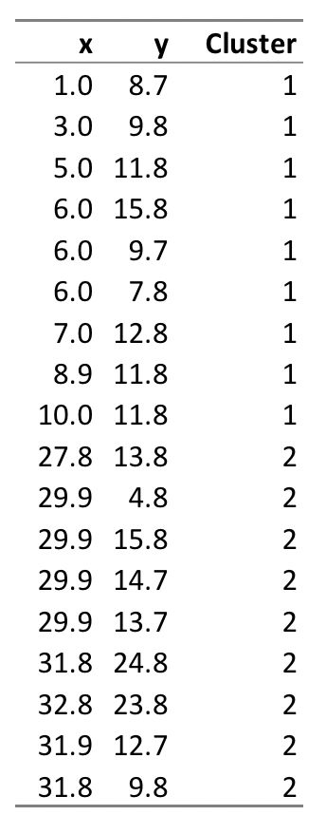
Homework 50 points
Write a MATLAB program to generate the two clusters based on the data
Print the output anyway you want
Cluster 1: object ……
Cluster 2 : object …….
Or
Cluster 1: (1.0,8.7); ……
Cluster 2: (27.8, 13.8)
Due before 5pm Dec. 7th

Slide 39
Principal Component Analysis (PCA)
Principal Component Analysis (PCA) is a simple yet powerful technique used for dimensionality reduction. Through it, we can directly decrease the number of feature variables, thereby narrowing down the important features and saving on computations.
Principal component analysis is a technique for feature extraction — so it combines our input variables in a specific way, then we can drop the “least important” variables while still retaining the most valuable parts of all of the variables! As an added benefit, each of the “new” variables after PCA are all independent of one another.

Slide 40
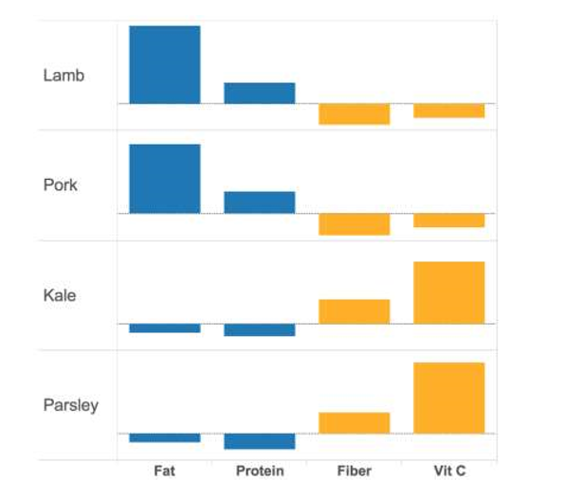
Among four food items described by four variables (nutrients)
Four kinds of food with four variables (4 dimensions) based on their nutrition: Fat, Protein, Fiber and VC
We can use Fat/Protein variables to differentiate meat and vegetable. But not enough differentiate the Lamb and pork
We decide to combine the original variables (fat, protein, fiber and vc) create new independent variables to separate these four food. (PCA analysis)

Slide 41
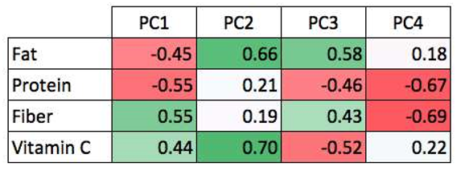
PCA analysis combine correlated(or not) variables and reduce variables
In PC1, fat and protein are correlated, while fiber and vc are correlated
PC1(pork) =-0.45*Fat-0.55*Protein+0.55*Fiber+0.44*Vc
In PC2, fat and vc are correlated, while fiber and protein are correlated
PC2 (pork)=0.66*Fat+0.21*Protein+0.19*Fiber+0.70*Vc
We can calculate PC1(Lamb), PC1(parsley)…………
Plot PC1 against PC2

Slide 42
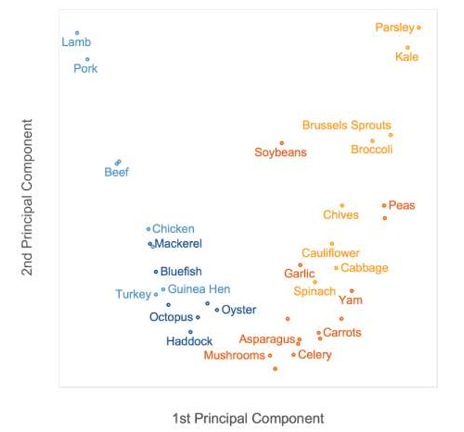

Slide 43
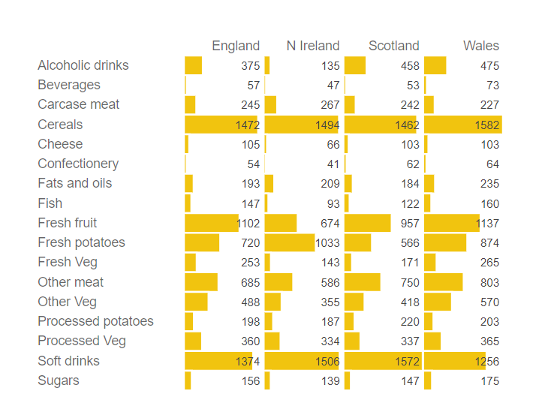
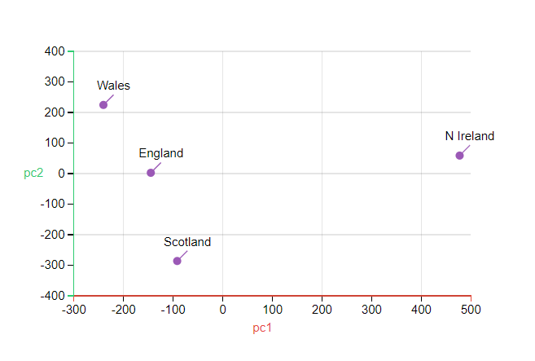
https://setosa.io/ev/principal-component-analysis/

Slide 44
Do you want to reduce the number of variables, but aren’t able to identify variables to completely remove from consideration?
Do you want to ensure your variables are independent of one another?
Are you comfortable making your independent variables less interpretable?

